Slide 1


An ISO 9001, 14001, OHSAS 18001 and ISO 27001 certified company
An ISO 9001, 14001, OHSAS 18001 and ISO 27001 certified company

Slide 2
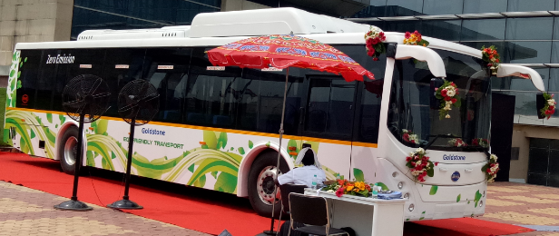
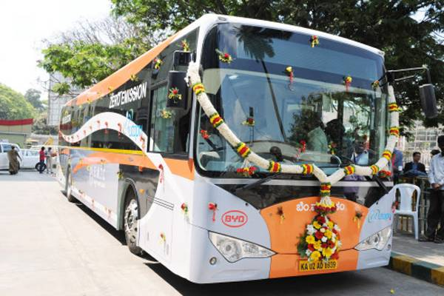
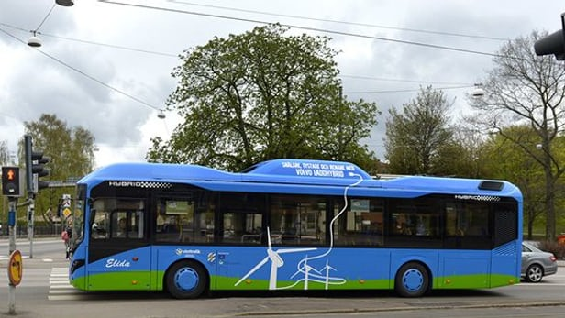
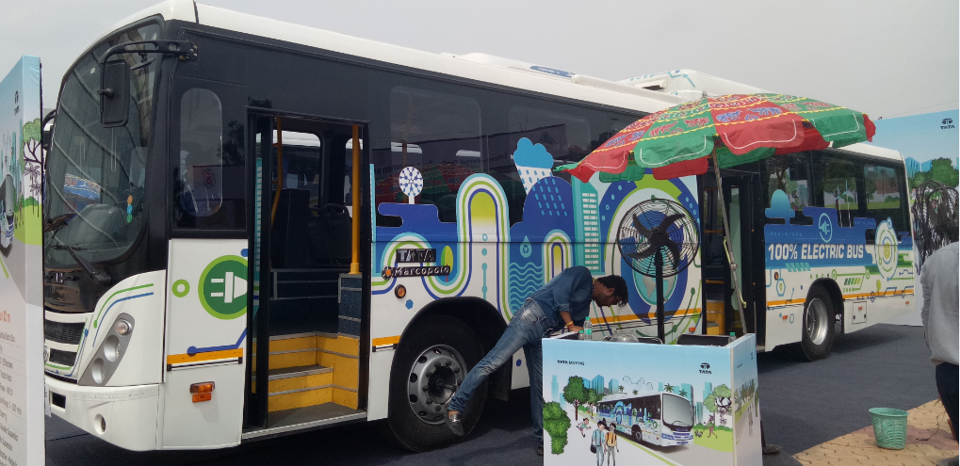

Implementation Strategy for Electric Vehicles
August, 2017
Delhi Integrated Multi Modal Transit System Limited

Slide 3
Electric Mobility
National Electric Mobility Mission Plan – 2020 aiming to introduce 5-7 million electric vehicles by 2020
- 3.5-5.0 million electric two wheelers
- 1.3-1.4 Hybrid Electric Bus (HEV-4W, Bus, LCV)
- 0.2-0.4 other pure electric vehicle (4W, Buses, LCVs)
In 2017, Niti Aayog formulated action plans to expedite the EV acceptance. The report found that the minimal penetration of EV bus and HOV was mainly because of lack of charging infrastructure
National Energy Policy-2017 has also directed to investment in manufacturing of EV/Hybrid vehicle and charging station
Launching Targets:
- Bharat Charger Published in May’ 2017
- E-Rickshaw/Auto: November-2017
- EV- Bus: January’ 2018

Slide 4
Electric Vehicle Mobility Project Components
DPR Feasibility Study
Operation Management
Infrastructure Creation
On Boarding of Rolling Stocks

Slide 5
Project Key Elements
Detailed Project Report Preparation
Preliminary Feasibility Survey
Primary data collection
Secondary data collection
Data Analysis
Project Management Consultancy
Deployment Planning
Performance Validation
Implementation Roadmap
Safety & Security
Govt. Policy (Transport, Electricity, Infrastructure)
Asset Renewability and Other usages
Economic Analysis and Business Modelling

Slide 6
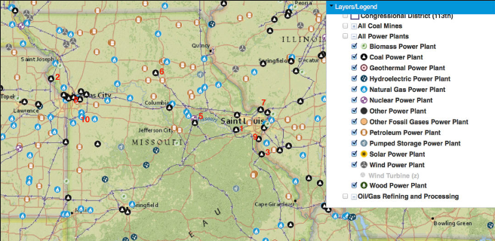
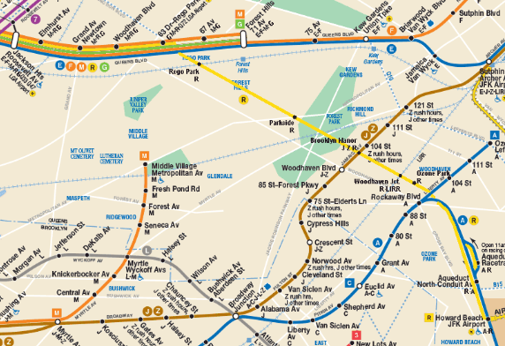
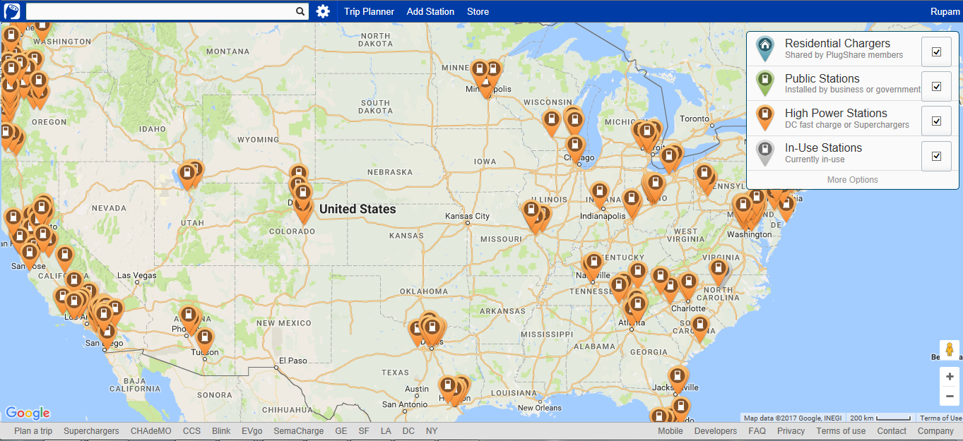
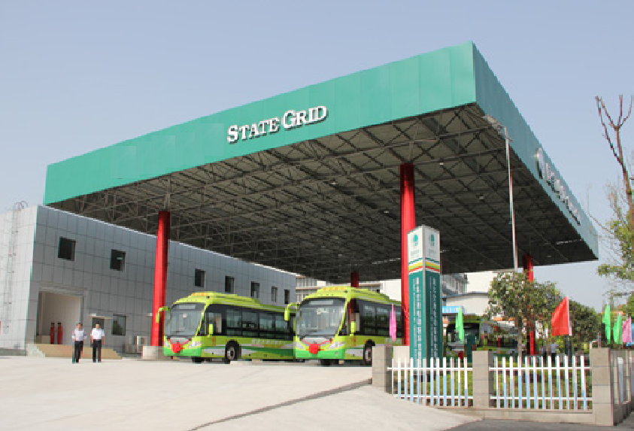
Preliminary Study Types

Slide 7
Primary Data Collection
Traffic Volume Count Survey
Origin-Destination Survey
Household Interview Survey
Speed & Delay Survey
Mass Transport/ Intermediate public transport passenger Survey
Intermediate Public Transit (IPT) User Survey
Public Transit (PT) User Survey
Parking Survey (2 to 4 Wheeler and Buses)
Road Side Electrical Infrastructure Study
Depot Infrastructure Survey (Electrical infrastructure inside depot)
I

Slide 8
Secondary Data Collection
Characteristics for existing demand for travel
Existing supply of Transport infrastructure including fleet size of mass transport system, operation, cost, performance, regulation and utilization
Demographic and socio-economic characteristics
Present and proposed land use pattern
Planned transport investments, policy changes and other government actions
Funding sources and expected funds available for transport improvements
Mapping power grid substation its Capacity
Depot design for creation of Charging station

Slide 9
DPR Feasibility Study
Perusal of Feebate Programmes of Govt to facilitate additional revenue
Restructuring Business model to include ZEV Credit Structure
ZEV Evaluation Study and Review
EV Ecosystem Incentive Study-Electricity, Vehicle, EV Utility(Parking, Lane, First/ Last mile connectivity & Fare Rebate) & EV Infrastructure
Institutional Framework
On Board ITS Deployment

Slide 10
DPR Feasibility Study
SWOT & PEST Analysis
Framework- MOD,IT Infrastructure, Vehicle Grid Integration Framework
Amenities planning and design
Capacity Building for Electric Bus Operations
Gap and Benchmark Analysis

Slide 11
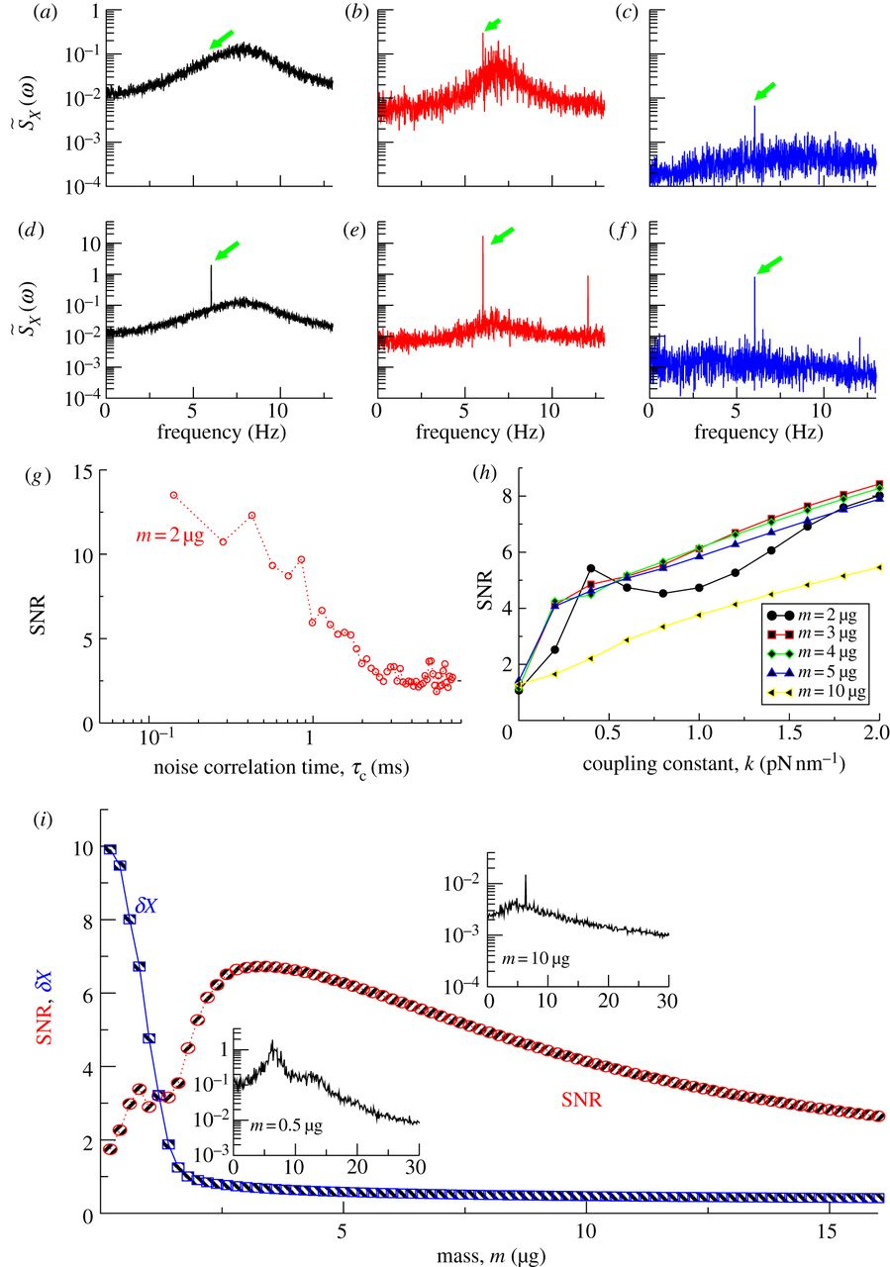
Few Data Analysis Outputs
Travel demand forecasting
Calibration of demand model
Demand modelling
Validation of traffic demand forecast
Planning of bus/IPT terminals
Provision of Charging station at roadside
Preparation ‘on- & off-street’ parking plans for charging
Suggest parking management measures
Identification of land use (Real Estate) as per Charging infrastructure stations
Travel demand modelling and forecast
Scope of passenger shift from existing modes to the recommended system
Formulation of transport strategy
Improvement measures/system selection
Planning of existing and new terminal infrastructure
Network characteristics
Planning for road improvement measures

Slide 12
Electric Vehicle Mobility Project Components
DPR Feasibility Study
Operation Management
Infrastructure Creation
On Boarding of Rolling Stocks

Slide 13
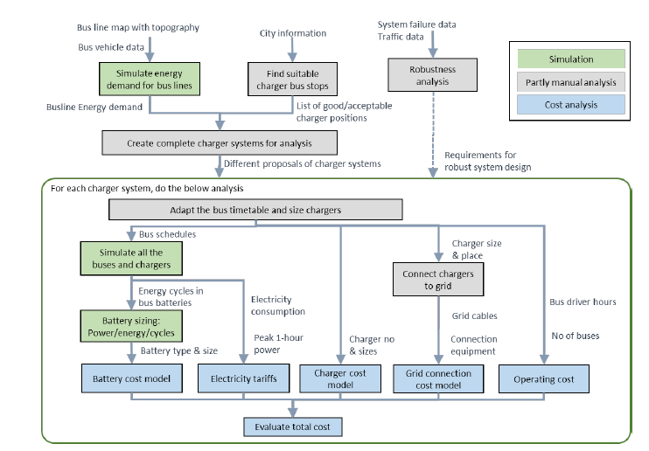
Electric Vehicle Mobility Project Components

Slide 14
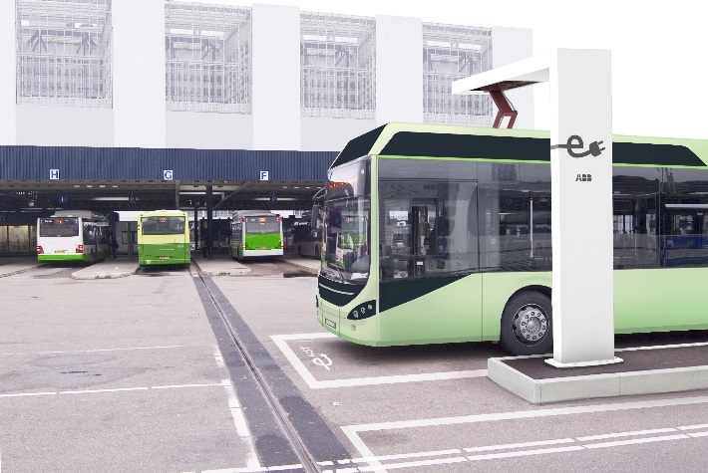
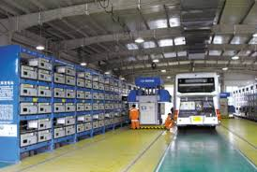
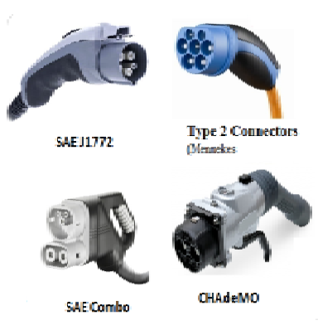
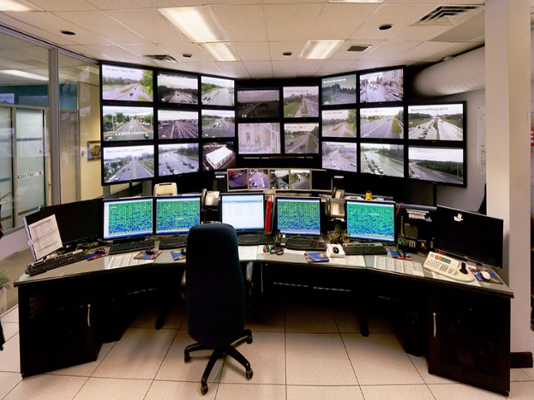
Infrastructure Charging Infrastructure Components
Charging Infrastructure
Level-1 Charging Infrastructure (Residential spaces, Offices, Household Supplies) 7-10 Hrs.
c
Level-3 Charging Infrastructure ( Petrol pumps, charging equipment's, vehicles) 10-30 Mins./ Battery Swapping System
Battery Swapping System
BMS (Battery Management System)
Bus telematics system
Communication with the cloud server
Connection with the Swapping station gateway
Hand Held Unit (HHU)
Multiple bulk chargers
Electric Vehicle Plug
AC Plug
(Yazaki Plug, Mennekes Plug, Scame Plug)
DC Plug
(CHAdeMO Plug, Combo Plug)
Addition EV Requirement
Mobile App/ Web Portal for Booking of Slots
Central Management Center
Metering & Billing System
Maintenance Mechanism
Signage
Lighting and Shelter
AC & Ventilation
Fire Protection System

Slide 15
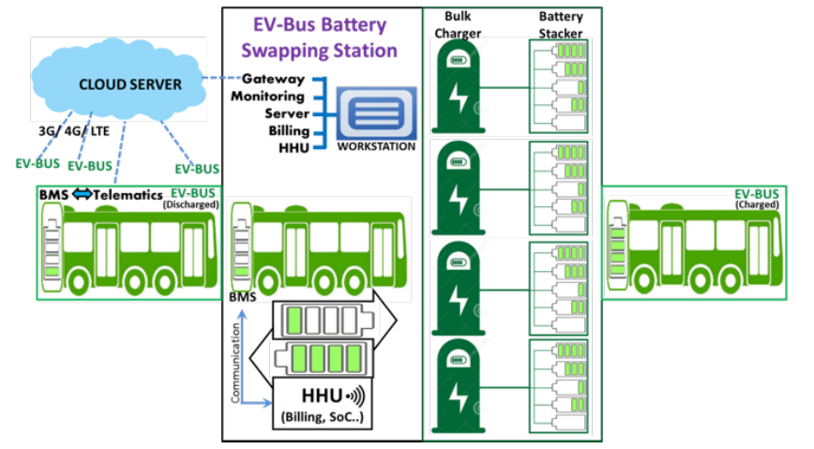
Charging Station Infrastructure
Identification of Land for new facilities for on-route charging
Facilities for Battery Storage/Swapping
Identification of Power Supply
Additional Infrastructure creation for substation grid to depot for charging facility
Identification of Space in depots
Battery charging Architecture design
Parking Space design

Slide 16
Project Management Consultancy for Infrastructure Creation
Charging Infrastructure feasibility
Vehicle and infrastructure prerequisites
Charging at depot
Charging at end stations
Charging at bus stops
Charging during movement
Design of Charging Infrastructure and its Standardization for Electric station
Vehicle Time Balancing & Charge Capability Management
Bid process management for selection of project implementing agency

Slide 17
Project Management Consultant
Business Models
Build-Own-Operate
Build-Maintain
Public Private Partnership
Design Build Own Operate Transfer
Drawing out Requisite Specifications for E-Mobility Ecosystem
Rolling out RFPs for Electric Bus, Supply & Garage Equipment
Implementation of ITS components
Plan->Supply->Installation->Go Live->Exit

Slide 18
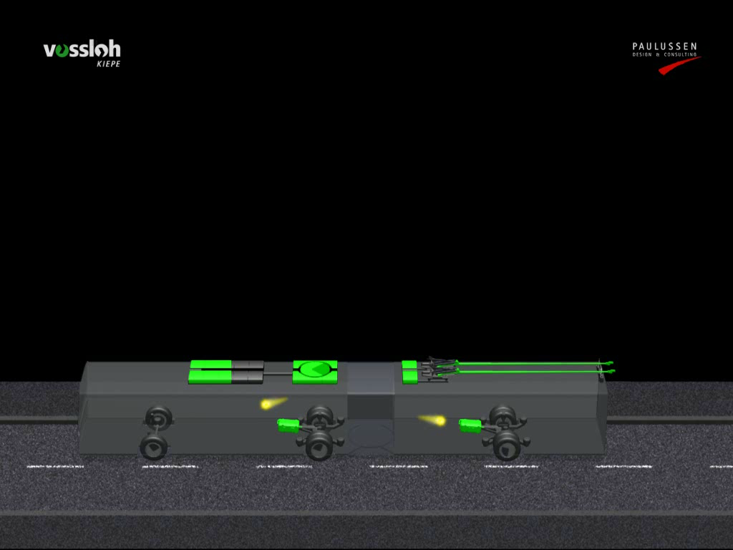
Hybrid Charging

Slide 19
Electric Vehicle Mobility Project Components
DPR Feasibility Study
Operation Management
Infrastructure Creation
On Boarding of Rolling Stocks

Slide 20
On Boarding of Rolling Stock
Bid process management of Electric buses as per availability and required specifications and its types
Route Selection, Planning and Rationalization
Contract Structuring
Demand Assessment
Selection of Electric buses as per
Battery Sizing
Charging availability and types

Slide 21
On Boarding of Rolling Stock
Assess the existing budgetary framework, adequacy and transparency
Assess the treasury management and timely availability and adequacy of funds
Detailed cost estimation for each component
Suggest mitigation measures to ensure timely access of funds, its expenditure accounting and auditing
Implementation Structure
Project Phasing with Cost Details
Net Cost | Gross Cost | Hybrid Model
Full Transfer of Revenue Risk | Only Operating Risk Transferred to the Operator | Flexibility of keeping focus on services while maintaining financial prudence.
Windfall gain if the regulator increases fares, or state owned buses underperform, or demand rises | Regulatory & operational flexibility to add routes, change frequencies and redeploy resources. | Varied solutions (i.e. more than one solution) across specific service requirements
Bids to factor-in all the risks associated with the bus operation – higher quotes | Price discovery to factor absence of market risk to the operator – possible lower quotes. | Varied solutions (i.e. more than one solution) across specific objective requirements

Slide 22
Electric Vehicle Mobility Project Components
DPR Feasibility Study
Operation Management
Infrastructure Creation
On Boarding of Rolling Stocks

Slide 23
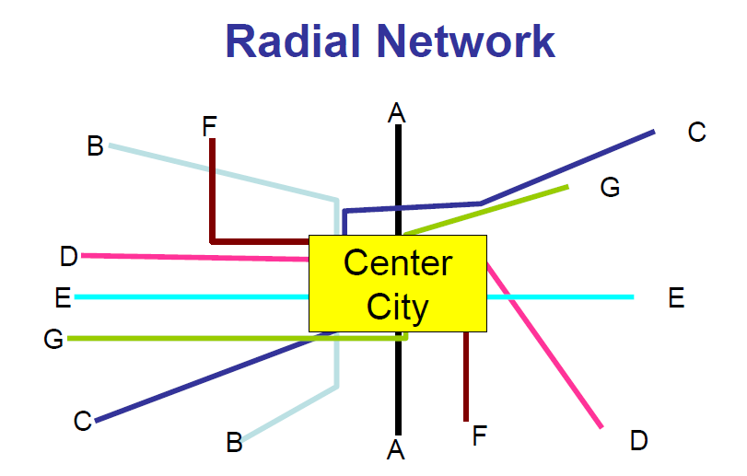
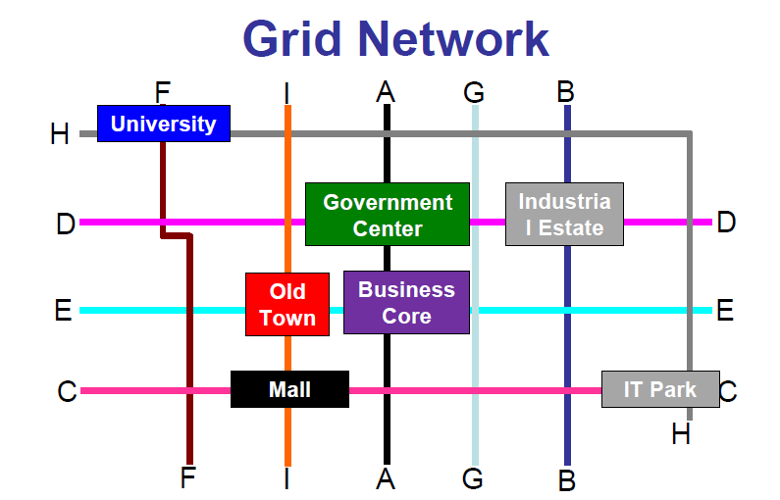
Electric Bus Operations
Bid Process Management for the selection of Operation Implementing Agency
Operation Readiness Assessment
Preparation of Operational Plan and Strategies
Alternate source of operation in case of temporary failure/breakdown
Routing Strategy
Frequency of Services considering the swapping/charging time requirement
Charging Payment Options –
Terminal Infrastructure for swapping/ charging and ITS Applications
- Real Time Information and way findings
- Terminals – green buildings
- Passenger facilities

Slide 24
Operations
IT Infrastructure Establishment & Monitoring
Establishing Key Performance Indicators
Annual Maintenance Structure
Deployment of manpower for monitoring of bus operations
Roll out of ITS Components for monitoring of bus operations & commuter information
Complete End-to-end Programme Management assistance to roll-out bus services

Slide 25
Next Steps…………….

